Slide 1
Preparing for the NACLO: Part 1
Notes:
This is the first lecture in a series meant to be a mini prep course for the North American Computational Linguistics Olympiad. Even though these problems are taken from the NACLO, they should be useful prep for linguistics olympiads in other countries as well (so feel free to adjust the contest name).

Slide 2
Basic Info About NACLO
NACLO = North American Computational Linguistics Olympiad
Register at http://nacloweb.org/register_student.php
2 rounds: Open Round (January 24) and Invitational Round (March 7)
Open Round: 3 hours, 8 problems
Invitational Round: 4 hours, 10 problems, usually harder
International Linguistics Olympiad teams are selected based on Invitational Round scores
2 US teams of 4, 1 Canadian team (Anglophone), 4 USA alternates, 2 Canadian alternates
Problems: logic puzzles about language and linguistics
Translation, numbers, maps, calendars, writing systems, phonetic systems, etc.
No prior knowledge required!
Main skill = logic, best way to develop is to do previous problems
Today: translation problems, chaos-and-order problems, writing systems
Notes:
Briefly introduce basic information about the NACLO, let them know how to register, explain the competition process and the types of problems (check out nacloweb.org for more information), emphasize that no prior knowledge is required and that the main skill is knowledge; change the dates to the dates of the competition the year you are giving this lecture
Today, we’ll be working on translation problems, chaos-and-order problems, and writing systems

Slide 3
Translation Problems
Task: Language A → Language B, Language B → Language A, Language X → English, English → Language X, etc.
Typical structure: words/phrases/sentences in 2 (sometimes 3) languages, matched up; task is to translate some items back and forth, figure out some new words
General strategy: look for words in common among the items, create a glossary; figure out prefix/suffix system and word order/grammatical structure
Notes:
Intro to the structure of a translation problem: basically, you’re usually given a list of words in 2 or more languages, and then the test is to complete some translations among the languages in a few directions
The general strategy is to look for words in common among the sentences and build up a glossary of words. Another strategy is to figure out how the prefixes and suffixes work as well as what order words appear in.

Slide 4
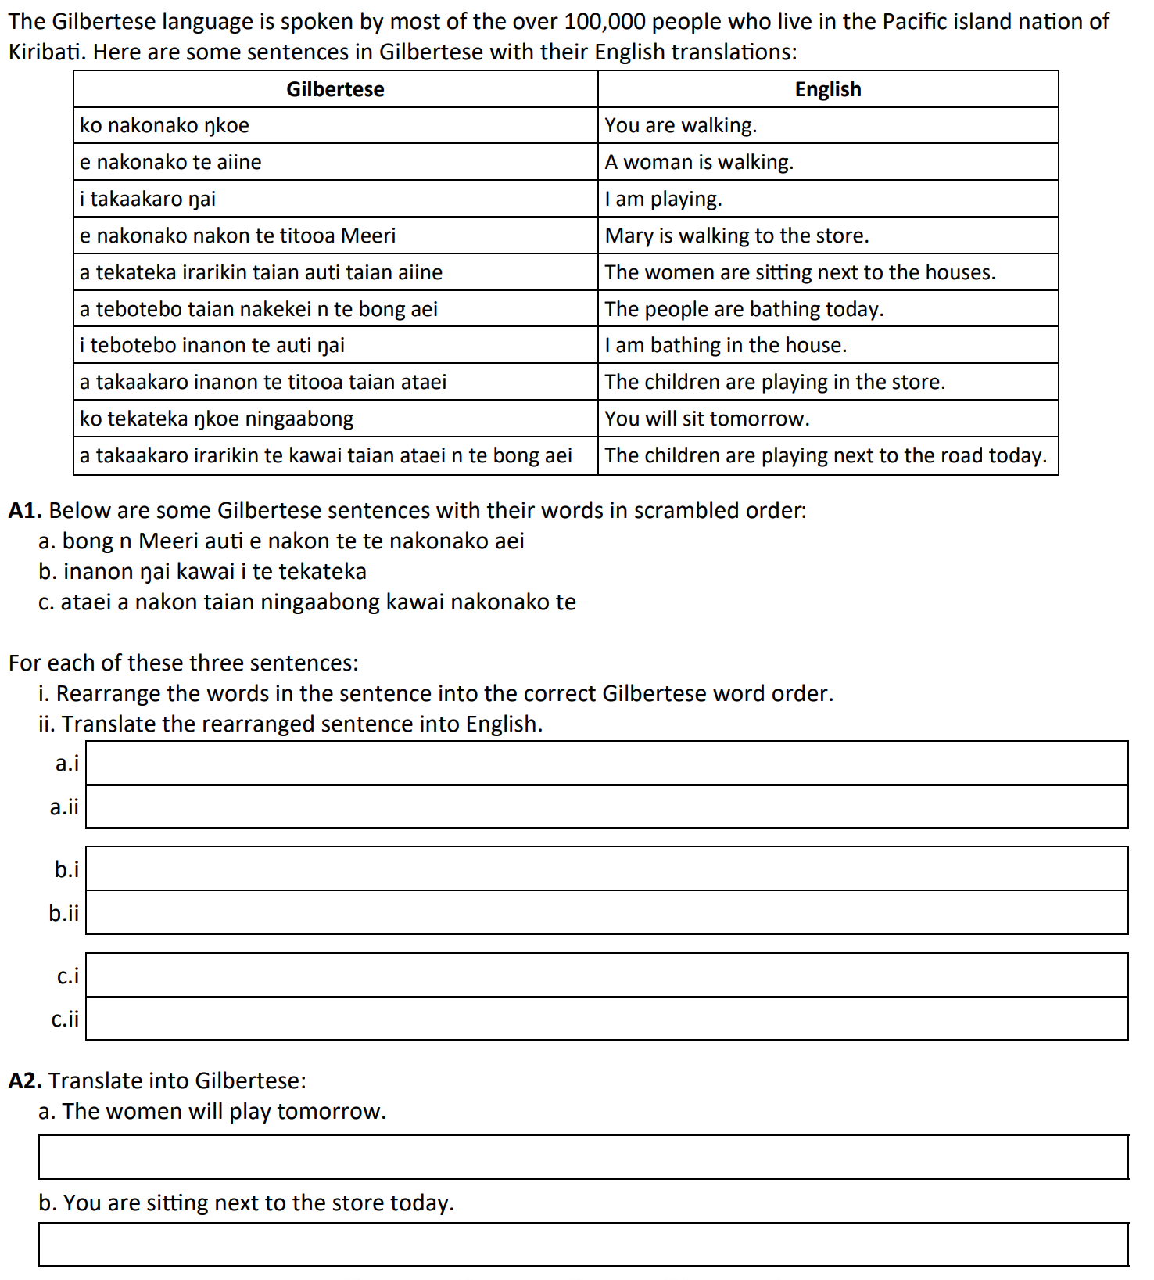
Example Problem
Grammar Rules
Word order: person marker, verb, prepositional phrase, subject, adverb
Nouns: article, noun
Verb conjugation: a, e, i, or ko before verb to indicate person, no tenses
Prepositional phrase: preposition, article, noun
nakonako
Meeri
aiine
e
a
takaakaro
tekateka
tebotebo
i
ko
n te bong aei
ŋkoe
ŋai
taian
irarikin
ataei
kawai
ningaabong
auti
nakon
inanon
titooa
walking
Mary
woman
is/will
are/will (3rd person pl.)
play
sit
bathe
am
are/will
today
you
I
the (plural)
next to
children
road
tomorrow
house
to
in
store
e nakonako nakon te auti Meeri n te bong aei
Mary is walking to the house today.
i tekateka inanon te kawai ŋai
I am sitting in the road.
a nakonako nakon te kawai taian ataei ningaabong
The children will walk to the road tomorrow.
a takaakaro taian aiine ningaabong
ko tekateka irarikin te titooa ŋkoe n te bong aei
Notes:
Guide:
Intro the problem--basically just like, “here’s a problem where we need to translate between Gilbertese and English.”
Here’s an outline of the solution (“click” means click the slide because there’s an animation)
Based on the word in common between sentences 1 and 2 and 4, nakonako = walking, click
Mary is obviously a cognate w/ Meeri, click
Based on common word between 2 and 5, “aiine” = “woman” or women, click
Based on remaining commonality between sentences 2 and 4, “e” means “is” or “will” for the singular third person, and we can mark that everywhere, click
Looking at sentences 5, 6, 8, and 10, “a” means “are” or “will” for the plural third person, and we can mark that everywhere, click
Based on sentences 3, 8, and 10 (word in common), takaakaro = playing, click
Based on the only common word between 5 and 9, tekateka = sit, click
Based on the only common word between 6 and 7, tebotebo = bathe
Either i or ŋai could be “I” or “am”, but looking at the subject-verb order of what we have figured out in sentence 5 (women comes at the end, a/are comes at the beginning), “i” is “am”, click
By the same reasoning, looking at 1 and 9, ko is “are” or “will” for the second person, click
Looking at sentences 6 - 10, we can be pretty sure that n te bong aei = today, click
The only word left in sentence 1 is “you”, so it has to be ŋkoe, click
The only word left in sentence 3 is “I”, so it has to be ŋai, click
Looking at the difference between the word before aiine in 2 and 5, we can infer that “te” is the singular “the” and taian is the plural “the”, and we can mark that everywhere, click
Now looking at 5 and 10, irarikin = next to, click
Now looking at 8 and 10, it’s pretty obvious that ataei = children, click
The only word left in 10 is kawai, which must be road, click
The only word left in 9 is ningaabong, which must be tomorrow, click
Either inanon or auti could mean “house” in sentence 7, but looking at sentence 10, we notice that the preposition comes before the location, so auti must be house, click
And inanon must be in, click, and that can be verified by sentence 9, click
And finally, looking at 4 and 8, titooa must be store, and those are all the words that we’ll need for this problem, click, click
Now, we have to consider word order, click
As we can observe from sentence ten, we have the person marker first (which is a or e or i, letting us know if the 1st/second/third person did it), and then the main verb, and then the preposition, and then the object of the preposition with an article before it, and then we have the subject which is the children, and then we have the adverb, today.
Based on that, we can unscramble the first sentence, click, and using our glossary, we can translate it, click
Similarly, we can figure out parts 1b and 1c, click
And using the same information, we can figure out question 2 as well, click

Slide 5
Chaos-and-Order Problems
Task: translate between/among 2 or 3 languages
Typical structure: 2 languages, words/phrases/sentences in each, scrambled order
Usual sub-questions: match the translations, use that information to translate back and forth
General strategy: look for repeated words, keep specific counts, build up info similarly to translation problem strategy
Then proceed as you do in translation problems
Easy clues include: question marks, exclamation marks, proper nouns (e.g. names)
Notes:
Introduce chaos and order problems: typically you’re given a list of sentences in 2 or more languages, but this time, they’re in scrambled order, so you don’t know which matches up with which, but your task is to figure it out
The general strategy is to first look for repeated words and keep counts of how many times each word appears (if one word in each language appears like 7 times, that’s a huge clue); other strategies are pretty similar to the translation problem strategies
Also look out for easy giveaways like question marks, exclamation marks, and names - those will often be good starting points

Slide 6
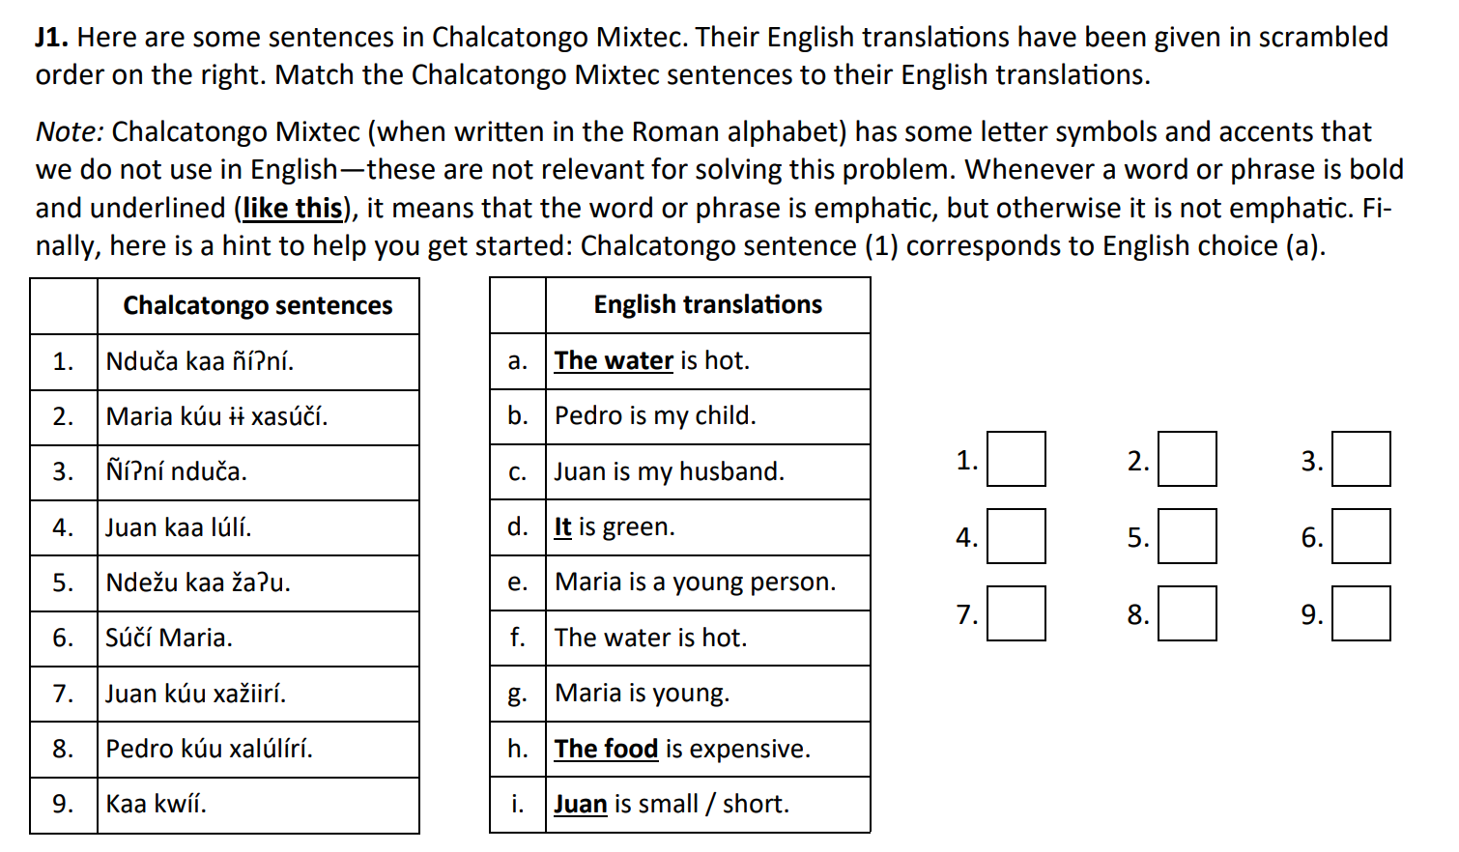
Example Problem
a
e
f
i
h
g
c
b
d
Notes:
So here’s an example problem, it’s back and forth between Chalcatongo mixtec and English. So first we’re given our freebie, which we can mark right away, click
Then, we notice that sentence b and sentence 8 are the only ones that contain the word “Pedro”, click, so they have to match up, click
And then, let’s take a look at the two sentences that have “Maria” in them, click
We can make a pretty confident guess that the shorter sentence in chalcatongo is going to correspond to the shorter sentence in English, so we can say 6 goes with g and 2 goes with e, click
Now let’s go back to this water sentence that we were given. Sentence f is the only other sentence that contains the word “water” or “hot,” and sentence 3 is the only sentence that has two words in common with sentence 1, click, so we know that 3 goes with f, click
And now, we observe the difference between 1 and 3. When the water is underlined, there’s an extra kaa word in there. And then, let’s look at the two sentences that contain “Juan”, click
One of them is underlined, and the other is not, and in Chalcatongo, one of them has that kaa word that we saw, and the other does not, so we can match those up, click
And finally, we have 5 and 9. They both have that kaa word in there because “it” and “the food” are both emphasized, but if we strip that out, we have two words in 5 and 1 word in 9. Food and expensive are distinct words, while “it” is often omitted or implied in a lot of languages, so we can be pretty confident that 9 goes with d click and 5 goes with h click, and that’s it!

Slide 7
Writing Systems
Task: transcribe between/among 2 or 3 writing systems
Typical structure: given transcriptions in all the languages, may be in or out of order, [match up] then transcribe back and forth
General strategy: attempt to look for repeated characters/symbols, pay attention to word length
Look for easy clues e.g. punctuation marks, 3-word phrases, really long words
Be careful: could be right to left writing!
Notes:
Another type of problem is a writing system problem, where you’re given transcriptions in a few languages that may or may not be in order, and your task is basically the same as chaos-and-order/translation problems, except you’re working with transcriptions instead
Similar general strategies: look for repeats and special punctuation as well as unique long phrases/words
IMPORTANT: not all writing systems go left to right, so make sure not to make that assumption unless it’s explicitly stated!

Slide 8
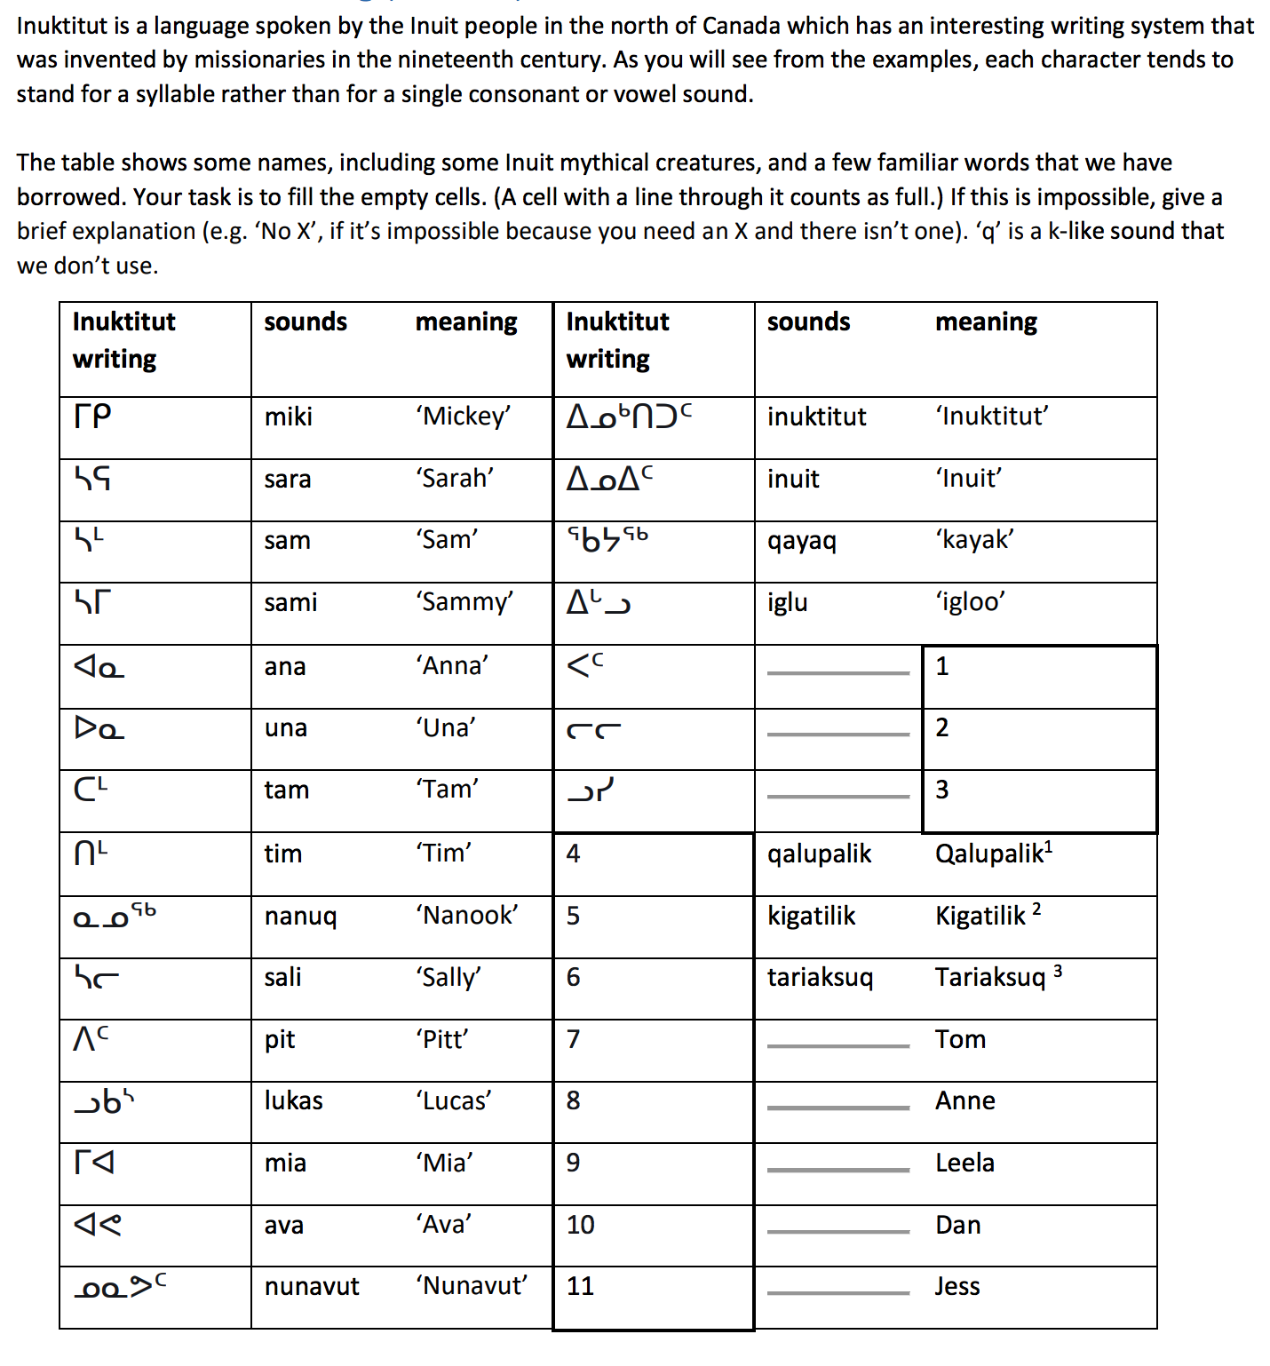
Example Problem
Notes:
So here’s our last example problem for today, in this language called Inuktitut. If we look at this system for a little while, we can notice the patterns in the writing. So as you can see in the description it says that each character probably stands for a syllable. So looking at our first word, we can hypothesize that the first character is “mi”, and the second character is “ki”. And to confirm that this system is left to right, we just look at words 2 3 and 4, which all start with sa and contain that same character on the left. And then, the last big thing to notice is the little superscripts. Since each character stands for a syllable, we can pretty easily figure out that those little superscripts denote some of those consonants at the ends of words, like the m at the end of Tam or Tim. And there’s one more weird thing, which is the q. In nanuq, the nu has two superscripts, but then if you look at qayaq, there’s one character preceded by a left side superscript. So when we solve number 4, we want to keep that rule in mind. And with that, for each question, we can just look through the given words for the syllable that matches the syllable in the word we’re trying to figure out, and we can mark accordingly. For some of them, the syllable isn’t there in our glossary, so we’ll just mark “impossible” for those. And here’s the solution (go to next slide)

Slide 9
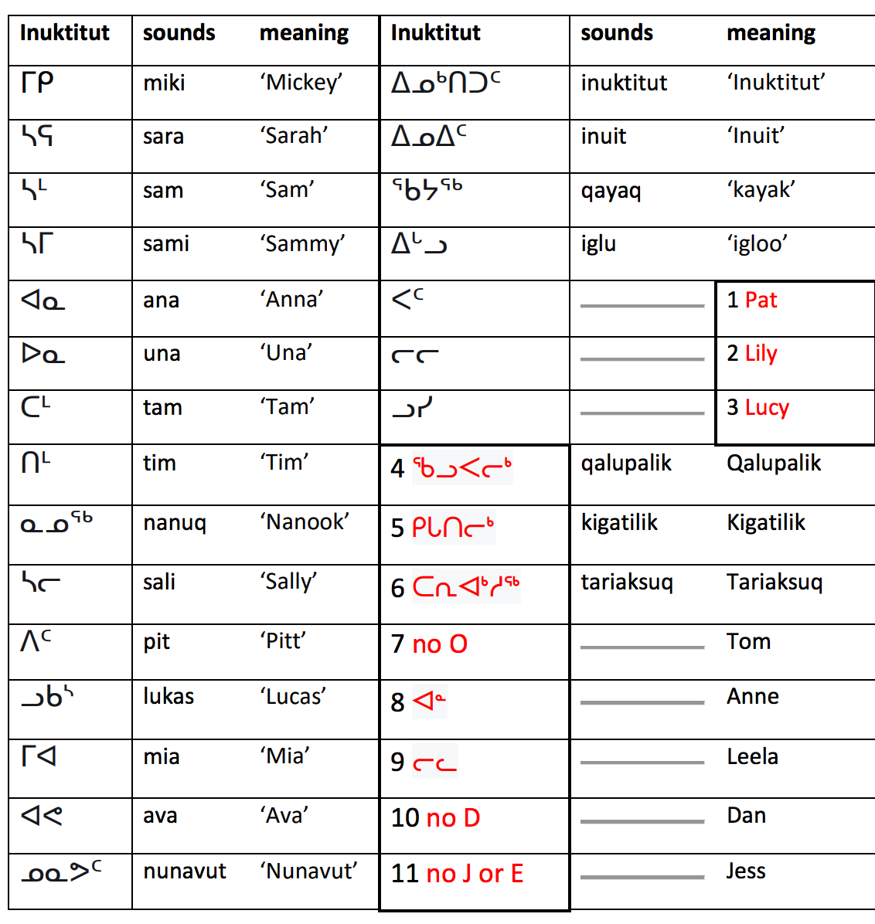
Solution

